Slide 1

Supply Chain Management
An insight into process flow with special focus on e-commerce businesses Presenter – Prashant S.

Slide 2

Know your Instructor
He is a Process leader at one of the largest manufacturing organization of the world . Worked on most of the modern day process improvement methodologies like CCPM, LEAN, TOC, TQM, SCM, Six sigma, Business process re-engineering, SMED, Statistical tools and POOGi tools. He has also conducted & Implemented SCM process designs across various domains of manufacturing and services.
Prashant S.
B.Tech, Mechanical, BIT Mesra
MBA, XLRI (Operations & Finance)
http://www.edureka.co/supply-chain-management

Slide 3






What will you learn today?
Introduction to Supply Chain Management and need for eSCM
What is SCM ? Its evolution and need.
Key role of SCM in E-commerce Industry and why should one learn about eSCM?
Creating a e-business supply chain
Flipkart and Amazon
SCM challenges in India
Warehousing or Marketplace
E-Commerce Logistics
SCM job opportunities in India
Roles/Responsibilities & Salaries
SCM Course at Edureka & Career benefits
Course link: www.edureka.co/supply-chain-management

Slide 4
What is Supply chain Management ?

Slide 5
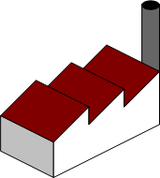




What is Supply Chain
The flow of material, information, money, and services from raw material suppliers through factories and warehouse to end customer
Includes manufacturers, suppliers, transporters, warehouses, retailers, and customers
It involves dynamic and constant flow of information, products and funds between different stages and stakeholders.
Customer is an most important and an integral part of the supply chain
A supply chain is typically consists of various sources and resources at various stages and hence we may be right in calling it “supply network” or “supply web” more accurately.
Supplier
Factory
Warehouse
Distribution
End Customer

Slide 6
Traditional view of a Supply Chain flow
Sub processes in each supply chain process cycle
Supplier stage market product
Buyer stage places order
Supply stage supplies orders
Buyer stage receives supply
Buyer returns reverse flows to supplier
Supply stage receives orders
Interdependencies in a supply chain management
Raw Material
Manufacturing
Retailer
End Customer
Information Flow
Material Flow
Fund Flow

Slide 7
But why the need for e-SCM?

Slide 8

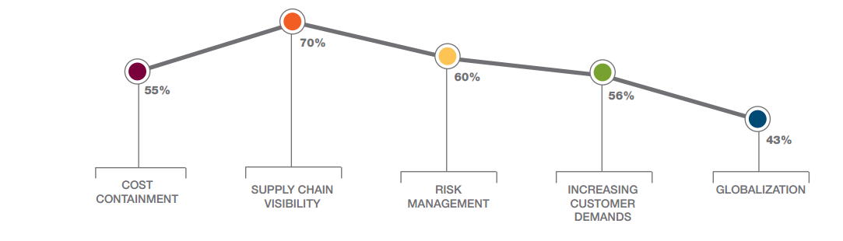
Supply Chain – Five major Challenges
Supply chains can be very long, involving many internal and external partners located in different places
Both materials and information must flow among several entities, and these transfers, especially when manually handled, can be slow and error-prone
Other problems along the EC supply chain mainly stem from the need to coordinate several activities and internal units and business partners

Slide 9
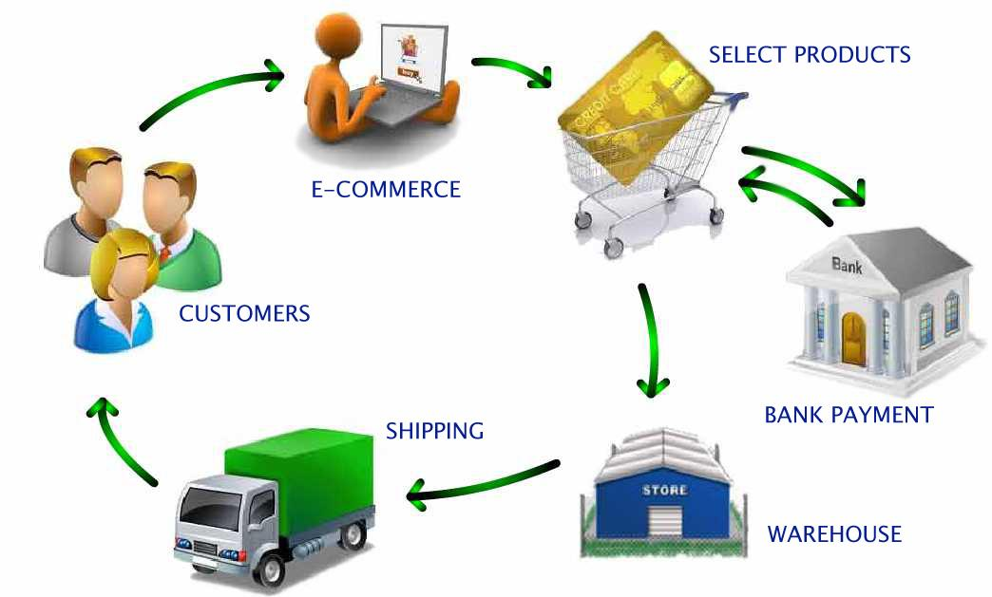
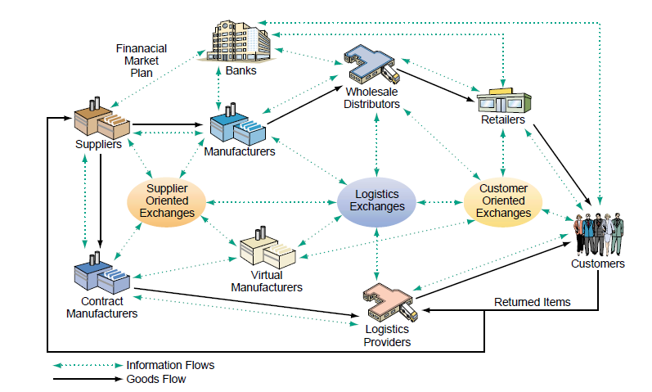
A typical e commerce supply chain management system
eSupply chain
A supply chain that is managed electronically, usually with Web technologies
Supply Chain Parts
Upstream supply chain
Internal supply chain
Downstream supply chain

Slide 10
Elements of eSupply Chain
Upstream
Internal
Downstream
Supplier Relationship Management, Procurement Management
Internal Value Chain, Manufacturing, Inventory Control
Distribution, Warehousing, Transportations
1st Tier Supplier
2nd Tier Supplier
Manufacturing
Packaging
Distribution Center
Retailer-w/housing
Customer
Key eSCM activities
e-Procurement
Supply chain monitoring and control
Collaborative planning
Collaborative design and product development
e-Logistics

Slide 11
How is it different from
traditional supply chain ?

Slide 12
Traditional retail supply chain structure
Information
Traditional SCM
Information
Information Flow
Vendor
Retailer Distribution Centre
Retail Outlets
Customer
Carrier
Carrier
Physical Flow
E-Comm SCM
Information Flow
Vendor/Supplier
Website & IT systems
Wholesale DC
Publisher/Mfg
Internet Retailer DC
Partner DC
Customer
Independent supplier/3rd party
Source: An Analysis of Current Supply Chain Best Practices in the Retail Industry with Case Studies of Wal-Mart and Amazon.com,Chiles and Dau, Georgia Tech

Slide 13
Let’s discuss few e-SCM in action
Flipkart , Amazon and DELL

Slide 14
Flipkart –Information and material flow
Shipping & Tracking ID
Customer Places order on Website
Order downloaded to Order Mgmt System
Order transmitted to nearest warehouse
Inventory mgmt system looks for the product
Order allocated from inventory
New PO raised for replenishment
Item sent for packing & shipping preparation
Item Shipped
Item Received at distribution Centre
Last mile delivery by Courier cos / Flipkart Internal Delivery arm / Indian Postal Service / DC personnel
Via courier companies / Flikart Self Delivery
Order Management System
2 Wheeler / Small van / Postal Service
Flipkart Generated Barcode

Slide 15
Flipkart – Logistical approach
25 Warehouses -7 previously, other converted from delivery centre
60 Delivery Centers - 35 previously, others newly formed (aim to reduce the time of delivery)
YES
SUCCESS!!!
Sent to logistics body
Customer order
Checked in delivery centre inventory
Delivery Time 1-2 Days
Checked in the
nearest warehouse
inventory
NO
YES
Automatic inventory check
via Inventory
management system
NO
Delivery time 2-5 Days
Ordered to the company
YES
Delivery time 6-15 Days

Slide 16
Amazon

Slide 17
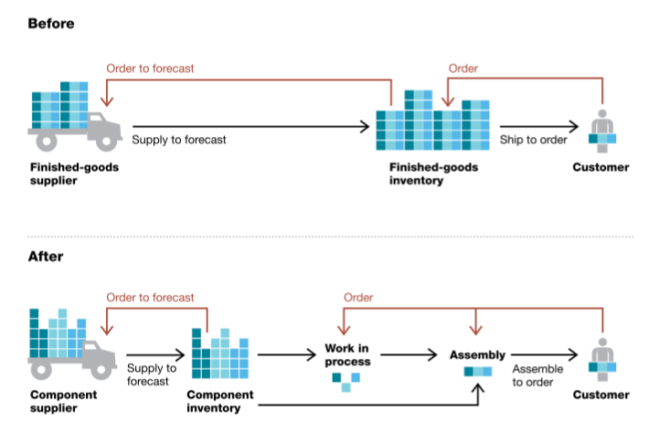
Dell

Slide 18
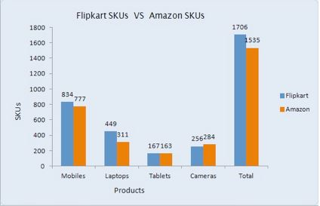
Flipkart and Amazon-Both Similar – but still different
Flipkart is a market place model while Amazon is an inventory guided marketplace model.
Flipkart has 1706 SKUs in stock and 4172 offers while Amazon has 1535 SKUs in stock and 2244 offers.

Slide 19
E Comm – Market place or warehouse
Operational flow in Market Place model
Operational flow in warehouse model
Parameters | Market Place | Ware house
Product Assortment | High | Moderate
Inventory Holding Cost | Incurred by Vendor | Incurred by company
Stock-out | Fewer due to pool of vendor available | High frequency as central regulation
Delivery Time | More because company depends on vendor shipping from its own warehouse | Less as company ships from warehouse
Vendor Relationship | Stringent vendor selection | Lesser stringent compared to MP

Slide 20
How are their products less expensive than in retail shops?
Merits for eSCM
Retail store (organized) | Online store
Need a shop floor or chain of shop floor. | Managed by centralized warehouses .
Need skilled sales and management staff | Need customer service associates.
Need branding and displays | No need for branding and displays of the product
Need to pay overheads such as electricity bill, telephone bill, stationeries etc at every store. | Comparatively less Expensive as overhead are born only for the dispatch centers
Need furniture and equipments which need maintenance at every store | Need few furniture and equipments which requires less maintenance cost

Slide 21
Strategies for Better Performance
Manage the process, not the function.
Align measurement systems and incentives with overall goals.
Utilize integrating mechanisms such as the sales and operations planning meeting, cross-functional teams, and team problem- solving approaches.
Work to develop a culture that encourages teaming and cross-functional collaboration.

Slide 22
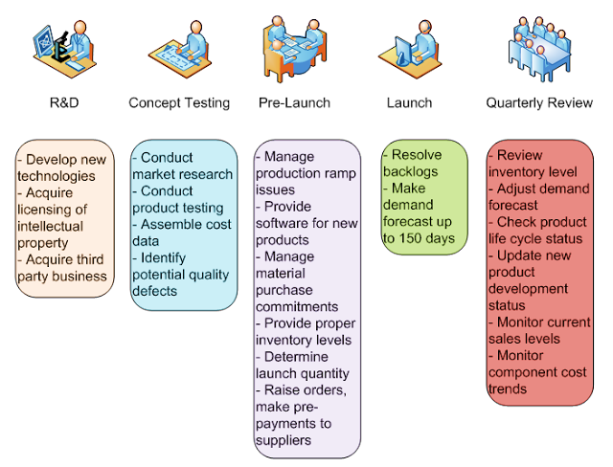
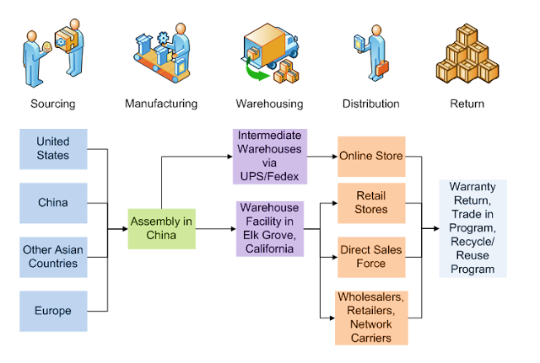
Now -Think and provide inputs on measures to convert a
Supply chain into eSupply Chain

Slide 23
E-commerce Logistics in India
$2
billion
Size of E-commerce Logistics in 2019
$18
billion
Size of online retail in India in 2018
Top Investments into E-commerce Logistics Companies
Delhivery raised $85 million in May from Tiger Global Management, Multiples Alternate Asset Management, Nexus Venture Partners and Times Internet Limited
Ecom Express raised $133 Million in June from Warburg Pincus
Snapdeal took a minority stake in GoJavas in March for an undisclosed amount

Slide 24
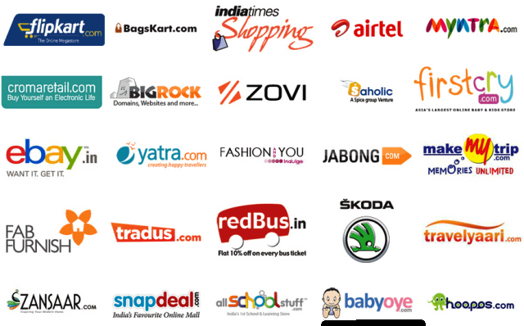
Career & Certifications

Slide 25
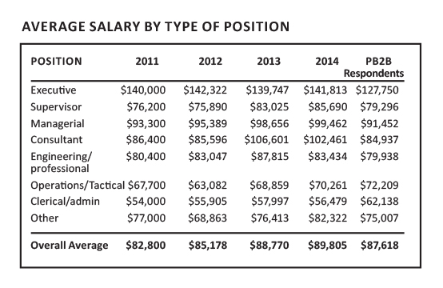
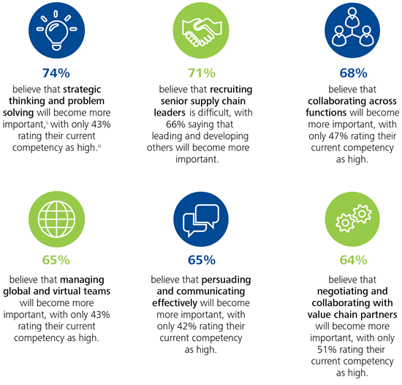
Job & Career Opportunities
Deloitte’s Supply Chain Leadership Survey of Supply Chain Executives
2014 Annual Survey US Supply Chain Professional

Slide 26

How Edureka course will help you scale up your career
APICS CPIM (APICS Certified in Production and Inventory Management)
CSCA (Certified Supply Chain Associate course)
CSCS (Certified Supply Chain Specialist course)
Go to www.edureka.co/supply-chain-management
Batch starts from 17th October (Weekend Batch)
Edureka's Supply Chain Management (SCM) course:
Scientifically designed course which intends to impart the knowledge related to various aspects of Supply Chain Management
Prepares you for global degrees in SCM from APICS CPIM, CSCA and CSCS
Online Live Courses: 16 hours
Assignments: 16 hours
Project: 20 hours
Lifetime Access + 24 X 7 Support

